Slide 1
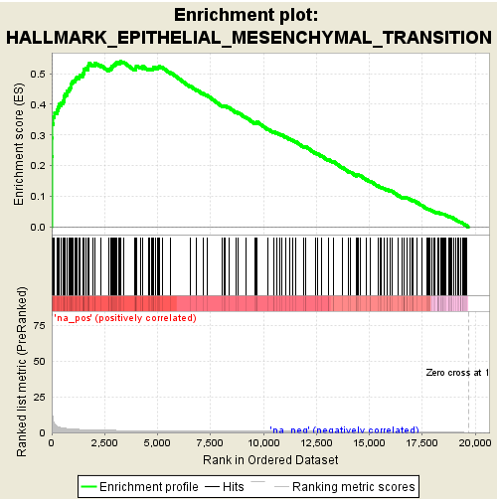
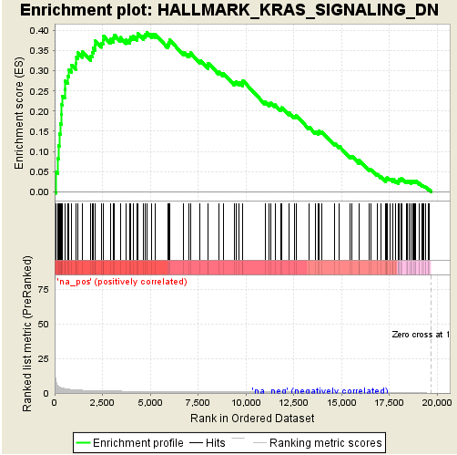
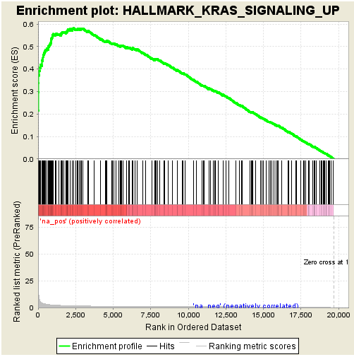
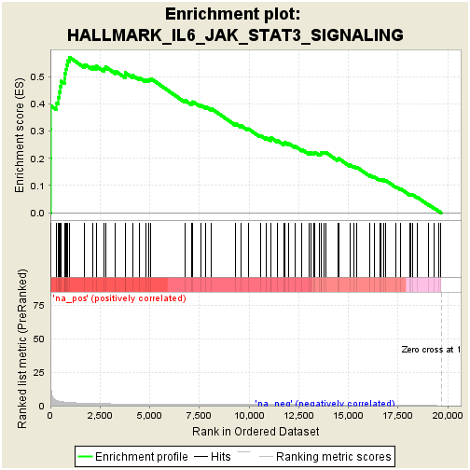
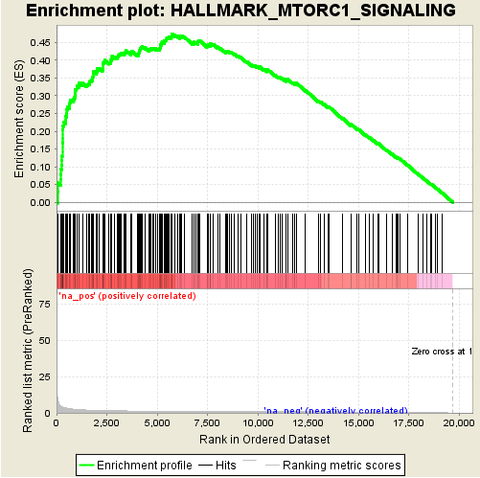
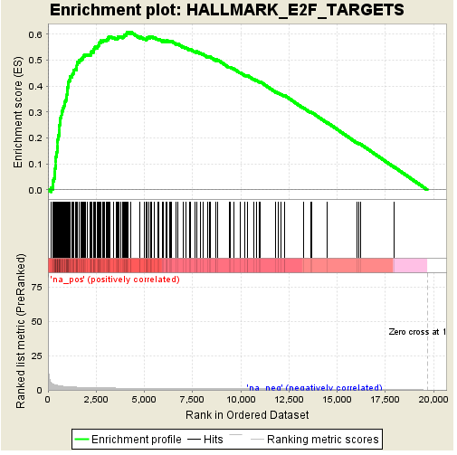
Figure S1. GSEA analysis
Figure S1: GSEA suggest that organoids induced under the conditions described in the manuscript undergo a marked transformation to a highly proliferative and malignant phenotype. Organoid induction was strongly associated with up-regulation in gene sets associated with epithelial-mesenchymal transition (p < 0.001), KRAS signaling (p < 0.001), IL6/JAK/STAT pathway signaling (p = 0.003), and other pathways commonly up-regulated in malignant tissues (e.g. MTORC signaling (p < 0.001) and E2F target signaling (p < 0.001).

Slide 2
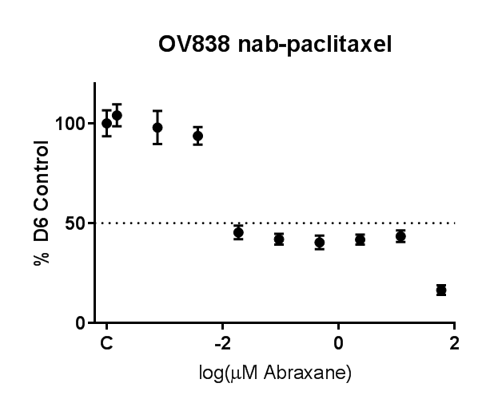
Figure S2. Representative nab-paclitaxel curve
Figure S2. Nab-paclitaxel yielded mixed results. Two specimens (OV820 and OV838) showed an inflection in the viability curve at low nab-paclitaxel concentrations (range of 0.01-0.26um). OV838 (represented here) also showed more inhibition with higher concentrations (range of 5.91-54.97 μM).

Slide 3
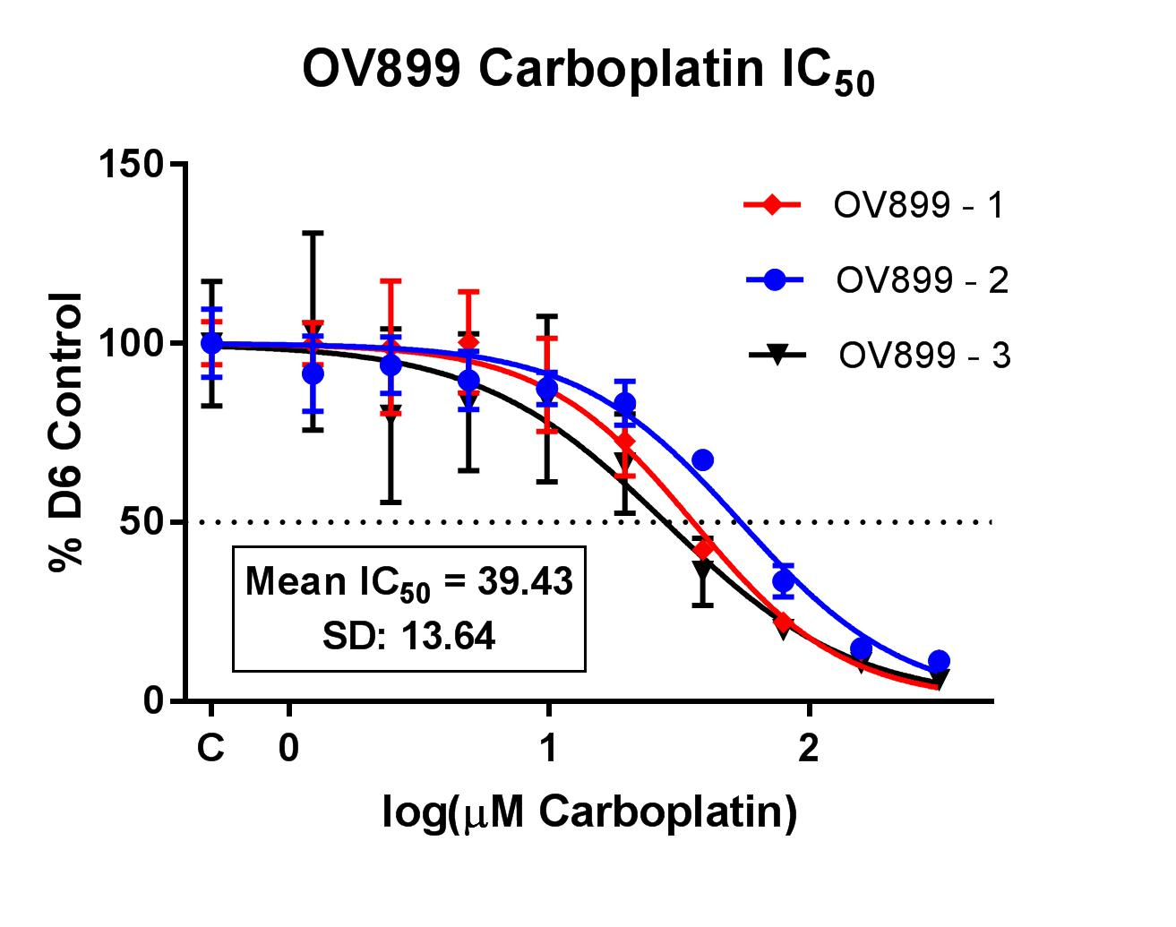
Figure S3: Example of IC50 curve in triplicate
Figure S3. IC50 curves were performed in triplicate when sufficient material was available. Here, OV899 Carboplatin IC50 curves are depicted in triplicate with the Mean and SD.

Slide 4
Figure S4:Representative examples of cell viability measured via ATP and average organoid area
a
b
Figure S4. a. ATP measured as Luminescence in samples at Day 1 and 6. Data are presented as mean with SD, n=6. b. Average organoid area is measured in samples at day 1 and day 6. Data are presented as mean with SD, n= 6.

